Slide 1
Web Security
Security, Privacy, and Consumer Protection Nick Feamster University of Chicago
Notes:
Welcome to the web security lecture. Today we'll cover fundamental concepts in web security, including how browsers protect users through the Same-Origin Policy, and the major classes of web vulnerabilities like Cross-Site Scripting (XSS), Cross-Site Request Forgery (CSRF), and SQL Injection. We'll also discuss SSL/TLS and how it provides secure communication on the web. These topics are critical for understanding how to build secure web applications and why certain design decisions were made in web security.

Slide 2
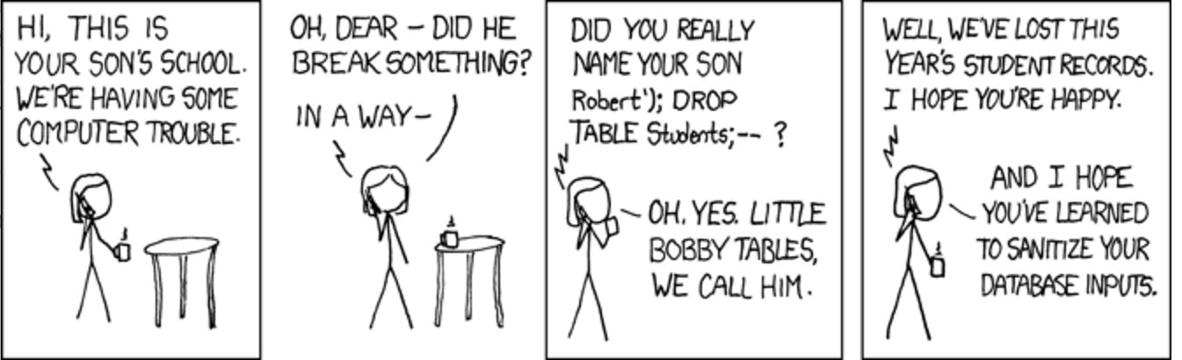
Notes:
This is the famous XKCD comic about SQL injection, titled "Exploits of a Mom." The comic illustrates how user input containing SQL commands can be executed by the database when not properly sanitized. The comic shows a mother naming her son "Robert'); DROP TABLE Students;--" which causes the school's database to delete the Students table when his name is entered. This perfectly captures the essence of injection attacks - confusing data with code.

Slide 3
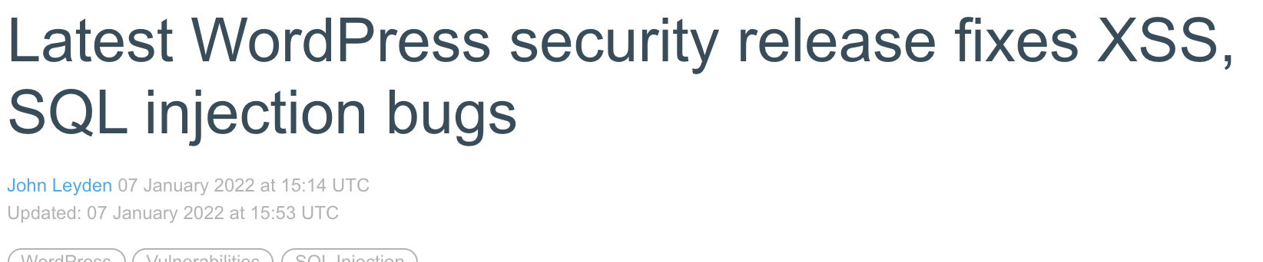
Notes:
[Slide appears to be blank or contain an image - this provides a transition or visual element in the presentation]

Slide 4
Browser Security
Goal: Prevent a malicious site from spying on or tampering with (1) my information or (2) interactions with other websites
Browsing to evil.com should not let evil.com spy on my emails in Gmail or buy stuff with my Amazon account
Defense: the same-origin policy
A security policy grafted on after-the-fact, and enforced by web browsers
Intuition: each web site is isolated from all others
Notes:
The fundamental goal of browser security is to prevent malicious websites from accessing or tampering with your data on other sites. For example, if you visit evil.com, it should not be able to read your Gmail inbox or make purchases on Amazon using your credentials. The defense mechanism that prevents this is called the Same-Origin Policy (SOP). The SOP is a critical security policy that was added to browsers after the web was already established, and it provides isolation between different websites. Think of it as creating a sandbox for each website so they can't interfere with each other.

Slide 5
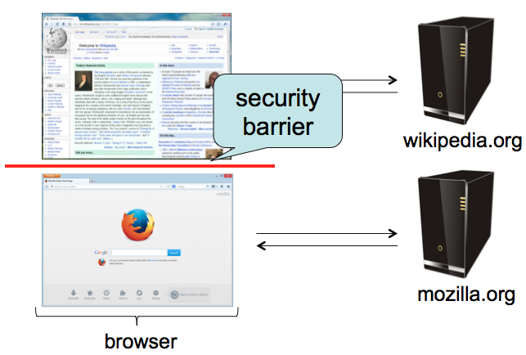
Same-Origin policy
Each site is isolated from all others
Notes:
This slide visually illustrates the Same-Origin Policy concept. Each website (represented by different domains) is isolated from all others. The SOP acts as a boundary or wall between different origins, preventing one site from accessing another site's resources. This is the foundation of web security - without it, any website could access your data on any other website.

Slide 6
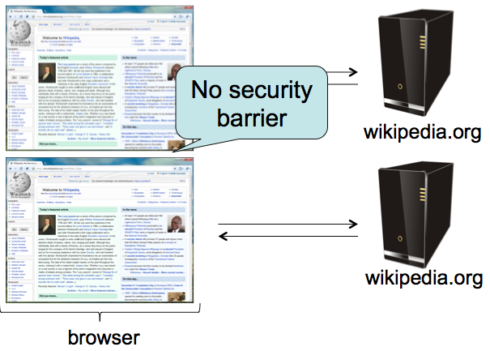
Same-Origin Policy
Multiple pages from same site aren’t isolated
Notes:
An important nuance: while different websites are isolated from each other, multiple pages from the SAME site are NOT isolated from each other. This means if you have gmail.com open in one tab and gmail.com/inbox in another tab, JavaScript from one can interact with the other. This is by design - pages from the same origin need to work together.

Slide 7
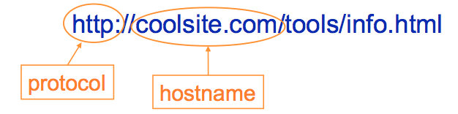
Same-Origin Policy
Granularity of protection: the origin
Origin = protocol + hostname + port
Javascript on one page can read, change, and interact freely with all other pages from the same origin
Notes:
An "origin" is defined by three components: protocol (http vs https), hostname (gmail.com vs facebook.com), and port (80, 443, 8080, etc). All three must match for two pages to be considered the same origin. For example, http://example.com:80 and https://example.com:443 are DIFFERENT origins because they use different protocols and ports. JavaScript running on a page can freely read, modify, and interact with any other page from the same origin, but is restricted from accessing pages of different origins.

Slide 8
Same-Origin Policy
Browsers provide isolation for JS scripts via the Same Origin Policy (SOP)
Simple version:
Browser associates web page elements (layout, cookies, events) with a given origin ≈ web server that provided the page/cookies in the first place
Identity of web server is in terms of its hostname, e.g., bank.com
SOP = only scripts from a web page’s origin have access to page’s elements
XSS: Subverting the Same Origin Policy
Notes:
The Same-Origin Policy rule is simple: only scripts from a page's origin can access that page's elements. Browsers isolate JavaScript scripts from different origins. Each web page element (the DOM layout, cookies, events, etc.) is associated with an origin, which is essentially the web server that provided the page. XSS (Cross-Site Scripting) is a way to subvert the Same-Origin Policy by injecting malicious scripts that execute in the context of a trusted origin.

Slide 9
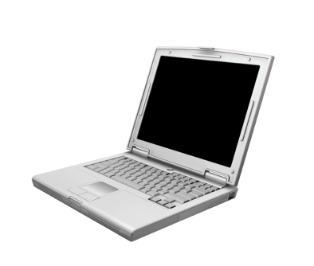




Web Overview (HTTP)
GET / HTTP/1.1 Host: gmail.com
HTTP/1.1 200 OK … <html>
<head>
<script>alert(‘Hi!’)</script>
</head>
<img src=“//gmail.com/img.png”/>
https://gmail.com/ says: Hi!
gmail.com
GET /img.png HTTP/1.1 Host: gmail.com
HTTP/1.1 200 OK … <89>PNG^M ...
Notes:
This slide shows a basic HTTP request-response cycle. The browser requests the root page from gmail.com, and the server responds with HTML that includes a script tag and an image tag. The key point: images can be loaded cross-origin, but their content cannot be read by scripts. This distinction is important for understanding SOP rules.

Slide 10


Same-Origin Policy
https://gmail.com/ says: { new_msgs: { from: “Bob”, msg: “Hi!”}}
gmail.com
$.get(‘https://gmail.com/chat.json’, { alert(data); })
GET /chat.json HTTP/1.1 Host: gmail.com
HTTP/1.1 200 OK … { new_msg: { from: “Bob”, msg: “Hi!”}}
Notes:
This slide demonstrates the Same-Origin Policy in action with modern JavaScript fetch requests. The code uses fetch() to request JSON data from gmail.com/chat.json. Since the script is running on gmail.com and fetching from gmail.com (same origin), this works fine. If this were attempted cross-origin, the browser would block it with an error: 'No Access-Control-Allow-Origin header is present.' This is the browser enforcing SOP.

Slide 11

AJAX (jQuery Style)
GET / HTTP/1.1 Host: gmail.com
HTTP/1.1 200 OK … <script> $.get(‘https://gmail.com/msgs.json’, { alert(data); }); </script>
https://gmail.com/ says: { new_msgs: 3}
gmail.com
$.get(‘https://gmail.com/msgs.json’, { alert(data); });
GET /msgs.json HTTP/1.1 Host: gmail.com
HTTP/1.1 200 OK … { new_msgs: 3 }
Notes:
This slide shows fetch() working correctly when the script and the resource are from the same origin. The page is served from gmail.com, and it fetches msgs.json from gmail.com. Since both are the same origin, the request succeeds and the data is displayed. This is the normal, secure operation of modern JavaScript fetch within a single origin.

Slide 12



Same-Origin Policy: Scripts
(evil!) facebook.com
GET / HTTP/1.1 Host: facebook.com
HTTP/1.1 200 OK … <script> $.get(‘https://gmail.com/msgs.json’, { alert(data); } </script>
$.get(‘https://gmail.com/msgs.json’, { alert(data); }
GET /msgs.json HTTP/1.1 Host: gmail.com
gmail.com
HTTP/1.1 200 OK … { new_msgs: 3 }
Notes:
This slide demonstrates the Same-Origin Policy blocking a cross-origin fetch request. The page is loaded from facebook.com (marked as evil), but the JavaScript tries to fetch data from gmail.com. The browser blocks this request because of SOP. The error shows: 'No Access-Control-Allow-Origin header...' This protection prevents facebook.com from stealing your Gmail data. Even though the script is trying to fetch from Gmail, it's executing in the context of facebook.com (different origin), so it's blocked.

Slide 13
Same-Origin Policy: Objects
GET / HTTP/1.1 Host: facebook.com
facebook.com
HTTP/1.1 200 OK … <img src=“https://gmail.com/img.png”/>
?
gmail.com
Notes:
This slide introduces another SOP rule: what happens when you try to load an object (like an image) cross-origin? Unlike fetch requests, images CAN be loaded cross-origin - you can embed an image from any site. However, there are restrictions on what you can do with that image.

Slide 14

Same-Origin Policy: Images
GET / HTTP/1.1 Host: facebook.com
facebook.com
HTTP/1.1 200 OK … <img src=“https://gmail.com/img.png”/>
GET /img.png HTTP/1.1 Host: gmail.com
gmail.com
HTTP/1.1 200 OK … <89>PNG^M ...
Notes:
This slide shows that images CAN be loaded cross-origin. Facebook.com can include an image from gmail.com using an <img> tag, and the browser will fetch and display it. However, while the image loads, JavaScript cannot read the image's pixel data or other content due to SOP. The image can be displayed but not inspected by scripts from a different origin.

Slide 15
Same-Origin Policy: <script>
GET / HTTP/1.1 Host: facebook.com
facebook.com
HTTP/1.1 200 OK … <script src=“https://gmail.com/chat.js”/>
?
gmail.com
Notes:
This slide asks what happens when you try to load a <script> tag from a different origin. The page is loaded from facebook.com but tries to load chat.js from gmail.com. Will scripts execute cross-origin? This is an interesting case because scripts need to execute, not just display.

Slide 16
Same-Origin Policy: <script>
GET / HTTP/1.1 Host: facebook.com
facebook.com
HTTP/1.1 200 OK … <script src=“https://gmail.com/chat.js”/>
$.get(‘https://gmail.com/chat.json’, { alert(data); })
GET /chat.js HTTP/1.1 Host: gmail.com
gmail.com
HTTP/1.1 200 OK … $.get(‘https://gmail.com/chat.json’, { alert(data); })
Notes:
This slide shows that <script> tags CAN load and execute code from different origins! Facebook.com loads chat.js from gmail.com, and that script executes. However, there's a crucial detail: once the script is loaded, what origin does it run under? This is important for understanding how script loading works in practice and why CDNs (Content Delivery Networks) can serve JavaScript libraries cross-origin.

Slide 17
Same-Origin Policy: <script>
$.get(‘https://gmail.com/chat.json’, { alert(data); })
gmail.com
GET /chat.json HTTP/1.1 Host: gmail.com
HTTP/1.1 200 OK … { new_msg: { from: “Bob”, msg: “Hi!”}}
Notes:
This slide continues the previous scenario. After the script from gmail.com is loaded into the facebook.com page, the script then tries to make a fetch request to gmail.com/chat.json. The question is: will this work? The answer depends on what origin the script is considered to be running under. Scripts take on the origin of the page they're embedded in, not where they were loaded from.

Slide 18
Same-Origin Policy: IFrame
GET / HTTP/1.1 Host: facebook.com
facebook.com
HTTP/1.1 200 OK … <iframe src=“https://gmail.com/chat”/>
?
gmail.com
Notes:
This slide introduces iframes (inline frames). The facebook.com page tries to embed gmail.com/chat inside an iframe. Will this work? Iframes are a way to embed entire web pages inside other pages, and they have special SOP rules.

Slide 19
Same-Origin Policy: IFrame
GET / HTTP/1.1 Host: facebook.com
facebook.com
$.get(‘https://gmail.com/chat.json’, { alert(data); })
HTTP/1.1 200 OK … <iframe src=“https://gmail.com/chat”/>
GET /chat HTTP/1.1 Host: gmail.com
gmail.com
HTTP/1.1 200 OK … <script> $.get(‘https://gmail.com/chat.json/’, { alert(data); }); </script>
Notes:
This slide shows that iframes CAN load cross-origin content. Facebook.com can embed gmail.com/chat in an iframe, and that iframe will load successfully. The iframe's script runs in the context of gmail.com (the iframe's origin), not facebook.com (the parent page's origin). This means the fetch request to gmail.com succeeds because it's same-origin from the iframe's perspective. However, the facebook.com page cannot access the content inside the gmail.com iframe due to SOP - there's a boundary between the parent and the iframe.

Slide 20
Code Injection
<?php
echo system(“ls ” . $_GET[“path”]);
GET /?path=/home/user/ HTTP/1.1
HTTP/1.1 200 OK … Desktop
Documents
Music
Pictures
Notes:
This slide introduces code injection vulnerabilities - the fundamental problem of mixing user data with code. The PHP code takes user input from the 'path' parameter and directly includes it in a system command. When the user provides '/home/user/', the command executes normally and lists the directory contents. The lack of input validation opens the door to attacks.

Slide 21


Code Injection
<?php
echo system(“ls ” . $_GET[“path”]);
GET /?path=$(rm –rf /) HTTP/1.1
<?php
echo system(“ls $(rm –rf /)”);
Notes:
This demonstrates shell injection: the attacker provides '$(rm -rf /)' which is a shell command that recursively deletes everything. The PHP code naively concatenates this into the ls command, resulting in 'ls $(rm -rf /)' which executes the malicious command. This is a catastrophic vulnerability. The key lesson: never trust user input and never directly concatenate it into commands or code.

Slide 22
Code Injection
<?php
echo system(“ls $(rm –rf /)”);
Confusing Data and Code
Programmer thought user would supply data, but instead got (and unintentionally executed) code
Common and dangerous class of vulnerabilities
Shell Injection
SQL Injection
Cross-Site Scripting (XSS)
Control-flow Hijacking (Buffer overflows)
Notes:
The fundamental problem is confusing data and code. The programmer expected the user to supply DATA (a directory path), but instead got CODE (a shell command) that was unintentionally executed. This pattern appears in many contexts: Shell Injection, SQL Injection, Cross-Site Scripting (XSS), and Control-Flow Hijacking (buffer overflows). All these vulnerabilities stem from the same root cause: treating untrusted input as code.

Slide 23
SQL: Structured Query Language
Language to ask (“query”) databases questions:
How many users live in Chicago?
“SELECT COUNT(*) FROM `users` WHERE location = ‘Chicago’”
Is there a user with username “bob” and password “abc123”?
“SELECT * FROM `users` WHERE username=‘bob’ and password=‘abc123’”
Attack!
“DROP TABLE `users`”
Notes:
This slide introduces SQL, the Structured Query Language used to query databases. The examples show common queries: counting users in Chicago, and authenticating a user by checking username and password. The third example shows a malicious query: 'DROP TABLE users' which would delete the entire users table. This foreshadows SQL injection attacks where attackers inject malicious SQL commands through user input fields.

Slide 24
SQL Injection
Consider an SQL query where the attacker chooses $city:
SELECT * FROM `users` WHERE location=‘$city’
What can an attacker do?
Notes:
This slide sets up an SQL injection scenario. The query 'SELECT * FROM users WHERE location=$city' is intended to find users in a specific city, where $city comes from user input. The question is: what can an attacker do by controlling the $city variable? Can they break out of the query's intended logic?

Slide 25
SQL Injection
Consider an SQL query executing on a web server where the attacker chooses $city:
SELECT * FROM `users` WHERE location=‘$city’
What can an attacker do?
$city = “Chicago’; DELETE FROM `users` WHERE 1=‘1”
SELECT * FROM `users` WHERE location=‘Chicago’; DELETE FROM `users` WHERE 1=‘1’
Notes:
This slide demonstrates SQL injection in action. The attacker sets $city to "Chicago'; DELETE FROM users WHERE 1='1". When concatenated into the SQL query, it becomes two separate statements. The single quote closes the string, the semicolon ends the SELECT statement, and then a malicious DELETE statement executes. The WHERE 1='1' ensures the DELETE affects all rows. By injecting SQL metacharacters (quote, semicolon), the attacker breaks out of the intended query structure and injects their own SQL commands.

Slide 26
Notes:
This is the same XKCD comic from earlier, now shown again after explaining SQL injection in detail. Students should now fully appreciate the joke: the student's name "Robert'); DROP TABLE Students;--" caused the Students table to be deleted due to SQL injection. The double dash (--) at the end is an SQL comment that prevents the rest of the query from causing syntax errors. This comic has become the canonical example of SQL injection in popular culture.

Slide 27
SQL Injection Defense
Make sure data gets interpreted as data!
Basic approach: escape control characters (single quotes, escaping characters, comment characters)
Better approach: Prepared statements – declare what is data!
$pstmt = $db->prepare(
"SELECT * FROM `users` WHERE location=?");
$pstmt->execute(array($city)); // Data
Notes:
The defense against SQL injection is to ensure that data is interpreted as data, not as code. The basic approach is to escape control characters like single quotes. However, the BETTER approach is to use prepared statements (parameterized queries). With prepared statements, you declare the structure of the query separately from the data: the database knows exactly what is a command and what is user data. The database will never interpret the data as SQL commands, preventing injection entirely.

Slide 28
Cross-Site Scripting (XSS)
<?php
echo “Hello, ” . $_GET[“user”] . “!”;
GET /?user=Bob HTTP/1.1
HTTP/1.1 200 OK … Hello, Bob!
Notes:
This slide introduces Cross-Site Scripting (XSS). The vulnerable PHP code takes user input from the 'user' parameter and directly echoes it into the HTML response. When the user provides 'Bob', the output is 'Hello, Bob!' This seems harmless, but what if the user provides HTML or JavaScript?

Slide 29
Cross-Site Scripting (XSS)
<?php
echo “Hello, ” . $_GET[“user”] . “!”;
GET /?user=<u>Bob</u> HTTP/1.1
HTTP/1.1 200 OK … Hello, <u>Bob</u>!
Notes:
This slide shows that the vulnerability allows HTML injection. When the user provides '<u>Bob</u>', the output is 'Hello, <u>Bob</u>!' with Bob underlined. The user input is interpreted as HTML, not just plain text. If HTML can be injected, can JavaScript be injected too?

Slide 30
Cross-Site Scripting (XSS)
<?php
echo “Hello, ” . $_GET[“user”] . “!”;
https://vuln.com/ says: XSS
GET /?user=<script>alert(‘XSS’)</script> HTTP/1.1
HTTP/1.1 200 OK … Hello, <script>alert(‘XSS’)</script>!
Click me!!! https://vuln.com/?user=<script>alert(‘XSS’)</script>
Notes:
This demonstrates a Cross-Site Scripting (XSS) attack. The attacker provides '<script>alert('XSS')</script>' as the user parameter. The vulnerable PHP code echoes this directly into the HTML, creating an executable script tag. When the page loads, the JavaScript executes. An attacker can create a malicious link and trick victims into clicking it. When victims click while logged into vuln.com, the malicious script executes in the context of vuln.com, potentially stealing cookies, session tokens, or performing actions on behalf of the user.

Slide 31
Review: Same-Origin Policy
(evil!) facebook.com
GET / HTTP/1.1 Host: facebook.com
HTTP/1.1 200 OK … <script> $.get(‘https://gmail.com/msgs.json’, { alert(data); } </script>
GET /msgs.json HTTP/1.1 Host: gmail.com
gmail.com
HTTP/1.1 200 OK … { new_msgs: 3 }
Notes:
This slide reviews the Same-Origin Policy to set up the explanation of why XSS is so dangerous. Remember, facebook.com cannot make fetch requests to gmail.com because of SOP - the browser blocks this cross-origin request. But XSS allows attackers to bypass this protection.

Slide 32
Cross-Site Scripting (XSS) Attack
(evil!) facebook.com
GET / HTTP/1.1 Host: facebook.com
HTTP/1.1 200 OK … <iframe src=“https://gmail.com/?user=<script> $.get(‘https://gmail.com/msgs.json’, { alert(data); }) </script>”></iframe>
$.get(‘https://gmail.com/ msgs.json’, function (data) { alert(data); })
GET /?user=<script>$.get(‘ … </script> HTTP/1.1 Host: gmail.com
gmail.com
HTTP/1.1 200 OK … Hello, <script>$.get(‘https://gmail.com/msgs.json’, { alert(data); }) </script>
Notes:
This slide shows how XSS allows an attacker to bypass the Same-Origin Policy. Evil facebook.com creates a page with an iframe that loads gmail.com with an XSS payload in the URL. The payload is a script that makes a fetch request to gmail.com/msgs.json. Because the XSS vulnerability causes this script to execute in the context of gmail.com, the fetch request is now SAME-ORIGIN from the browser's perspective. The script is running on a gmail.com page, so it can access gmail.com resources. This is why XSS is so dangerous - it completely undermines the Same-Origin Policy.

Slide 33
Cross-Site Scripting (XSS) Attack
(evil!) facebook.com
GET / HTTP/1.1 Host: facebook.com
HTTP/1.1 200 OK … <iframe src=“https://gmail.com/?user=<script> $.get(‘https://gmail.com/msgs.json’, { alert(data); }) </script>”></iframe>
https://gmail.com/ says: { new_msgs: 3 }
$.get(‘https://gmail.com/ msgs.json’, function (data) { alert(data); })
GET /msgs.json HTTP/1.1 Host: gmail.com
gmail.com
HTTP/1.1 200 OK … { new_msgs: 3 }
Notes:
The injected script successfully fetches private data from gmail.com because it's executing in gmail.com's origin context. The alert shows the private data: {new_msgs: 3}. The attacker (evil facebook.com) has successfully stolen data from gmail.com by exploiting an XSS vulnerability. This demonstrates why XSS is one of the most dangerous web vulnerabilities - it allows attackers to execute arbitrary JavaScript in the context of trusted websites.

Slide 34
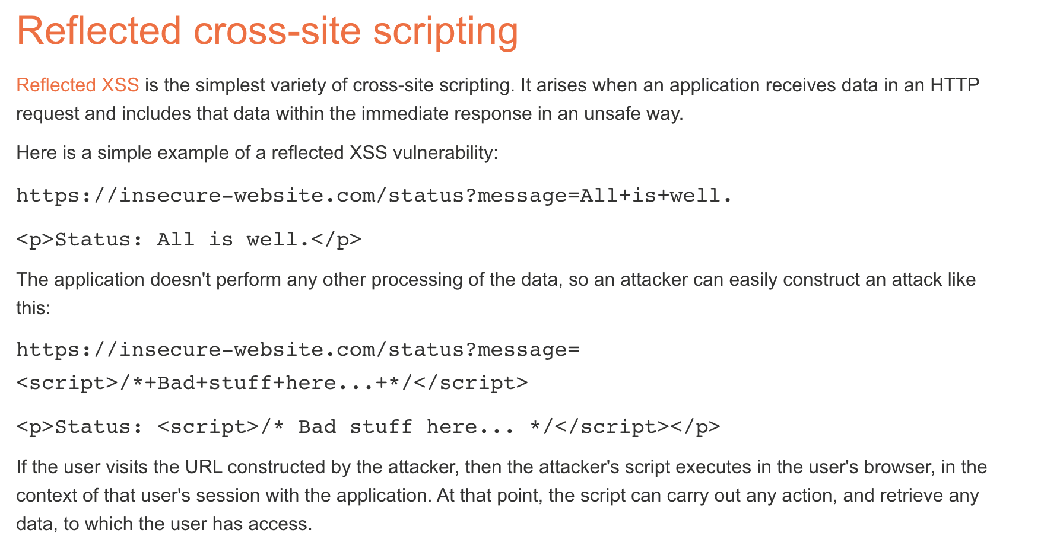
Notes:
This note references PortSwigger's excellent guide on Cross-Site Scripting. PortSwigger is a web security company that makes Burp Suite, a popular web application security testing tool. Their Web Security Academy is an excellent resource for learning about XSS and other web vulnerabilities in depth. Students should check out this resource for more detailed examples and practice labs.

Slide 35
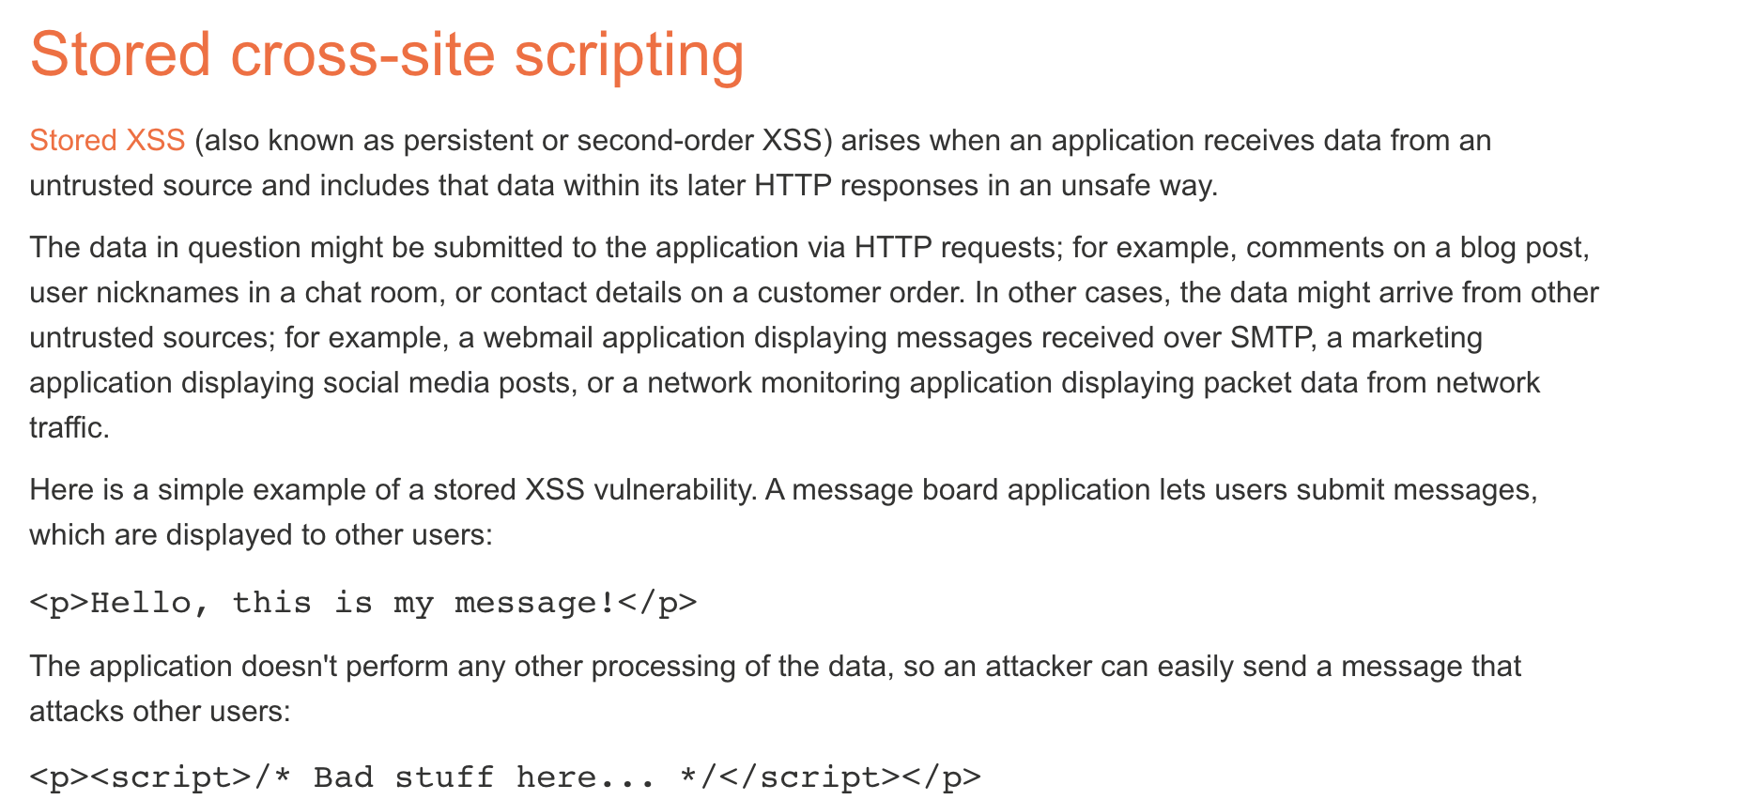
Notes:
[Slide appears to be blank or contain an image - possibly a screenshot or diagram related to XSS]

Slide 36
XSS Defenses
Make sure data gets shown as data, not executed as code!
Escape special characters
Which ones? Depends what context your $data is presented
Inside an HTML document? <div>$data</div>
Inside a tag? <a href=“https://site.com/$data”>
Inside Javascript code? var x = “$data”;
Make sure to escape every last instance!
Frameworks can let you declare what’s user-controlled data and automatically escape it
Notes:
The defense against XSS is to ensure that data is displayed as data, not executed as code. You need to escape special characters that have meaning in HTML and JavaScript. Which characters to escape depends on the context: inside HTML content, inside tag attributes, or inside JavaScript strings. The challenge is remembering to escape EVERY instance of user-controlled data. Modern web frameworks help by providing templating systems that automatically escape data by default. Content Security Policy (CSP) headers provide an additional layer of defense by restricting which scripts can execute.

Slide 37
Web Overview (HTTP)
GET / HTTP/1.1 Host: gmail.com
HTTP/1.1 200 OK … <html>
<head>
<script>alert(‘Hi!’)</script>
</head>
<img src=“//gmail.com/img.png”/>
https://gmail.com/ says: Hi!
gmail.com
GET /img.png HTTP/1.1 Host: gmail.com
HTTP/1.1 200 OK … <89>PNG^M ...
Notes:
This slide repeats the basic HTTP request-response cycle from earlier, setting up the introduction to CSRF (Cross-Site Request Forgery). We're about to explore a different type of attack that exploits how browsers automatically include credentials with requests.

Slide 38
Cross-site Request Forgery (CSRF)
fde874 = bob
Suppose you log in to bank.com
POST /login?user=bob&pass=abc123 HTTP/1.1 Host: bank.com
bank.com
HTTP/1.1 200 OK Set-Cookie: login=fde874 ….
Notes:
This slide introduces Cross-Site Request Forgery (CSRF). The scenario starts with you logging into bank.com by submitting your username and password. The server responds with a cookie (login=fde874) that represents your authenticated session. This session cookie is the key to CSRF attacks - it's automatically sent with every request to bank.com.

Slide 39
Cross-site Request Forgery (CSRF)
fde874 = bob
GET /account HTTP/1.1 Host: bank.com
Cookie: login=fde874
bank.com
HTTP/1.1 200 OK ….
$378.42
Notes:
This slide shows normal authenticated usage. When you make a GET request to /account, the browser automatically includes the login cookie with the request. The server sees the cookie, knows you're bob, and returns your account balance. This automatic inclusion of cookies is convenient but also creates security issues.

Slide 40
Cross-site Request Forgery (CSRF)
fde874 = bob
Click me!!! https://bank.com/transfer?to=badguy&amt=100
GET /transfer?to=badguy&amt=100 HTTP/1.1 Host: bank.com
Cookie: login=fde874
bank.com
HTTP/1.1 200 OK ….
Transfer complete: -$100.00
Notes:
This slide demonstrates a CSRF attack. The attacker creates a malicious link: https://bank.com/transfer?to=badguy&amt=100. If you click this link while logged into bank.com, your browser will automatically include your login cookie with the request. The server sees a valid authenticated request to transfer $100 and executes it. The key vulnerability: the server cannot distinguish between a legitimate request initiated by you and a malicious request initiated by an attacker-controlled link. This is called Cross-Site Request Forgery because a different site can forge requests using your credentials.

Slide 41
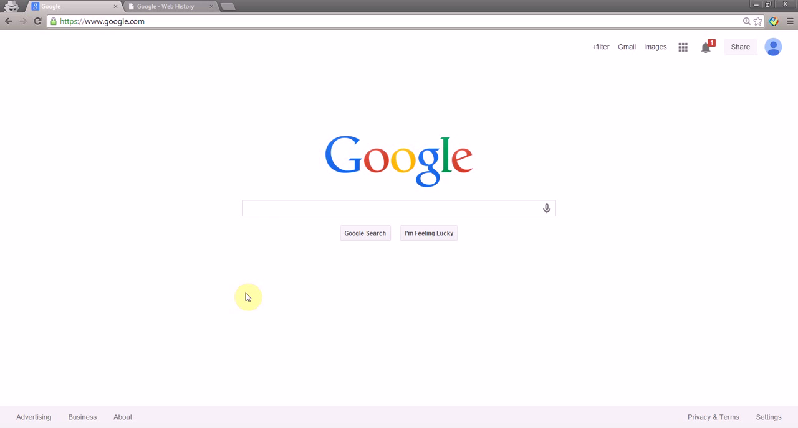
Profile Pollution with CSRF
Take This Personally: Pollution Attacks on Personalized Services. X. Xing, W. Ming, D. Doozan, A. Snoeren, N. Feamster, W. Lee. In USENIX Security Symposium, 2013.
Notes:
This slide references a research paper on profile pollution attacks using CSRF. The paper demonstrates how attackers can use CSRF to inject unwanted data into users' profiles on personalized services - for example, adding items to your Amazon shopping history, polluting your Netflix recommendations, or modifying your social media profile. The paper shows real-world CSRF vulnerabilities in major web services.

Slide 42
CSRF Defenses
Need to “authenticate” each user action originates from our site
One way: each “action” gets a token associated with it
On a new action (page), verify the token is present and correct
Attacker can’t find token for another user, and thus can’t make actions on the user’s behalf
Notes:
The core CSRF problem is that the server cannot verify whether a request was intentionally initiated by the user or forged by an attacker. The solution is to authenticate each user action by including a token that attackers cannot obtain or predict. On each page that performs an action, the server generates a random CSRF token and embeds it in the page. When the action is submitted, the server verifies the token is present and correct. Since an attacker on a different site cannot know the token value (and cannot read it due to SOP), they cannot forge valid requests.

Slide 43
CSRF Defenses
Pay $25 to Joe: https://bank.com/transfer?to=joe&amt=25&token=8d64
fde874 = bob
<input type="hidden" name=”token" value="8d64" />
HTTP/1.1 200 OK Set-Cookie: token=8d64 ….
bank.com
GET /transfer?to=joe&amt=25&token=8d64 HTTP/1.1 Host: bank.com
Cookie: login=fde874
HTTP/1.1 200 OK ….
Transfer complete: -$25.00
Notes:
This slide shows CSRF defense in action with tokens. When you load the transfer page, the server sends a CSRF token (8d64) in a hidden input field. When you submit a transfer, the form includes both the regular parameters (to, amt) and the token. The server checks the token matches before executing the transfer. An attacker trying to forge a CSRF attack cannot include the correct token because: (1) they don't know the token value (it's random and session-specific), and (2) they can't read it from your bank.com page due to Same-Origin Policy. The token proves the request originated from a legitimate page.

Slide 44
Modern CSRF Defense: SameSite Cookies
The Problem with Traditional Cookies:
Browsers automatically send cookies with EVERY request to a domain,
even requests initiated by other sites (enabling CSRF)
SameSite Cookie Attribute (Modern Solution):
Set-Cookie: session=abc123; SameSite=Strict
Set-Cookie: session=abc123; SameSite=Lax
Set-Cookie: session=abc123; SameSite=None; Secure
Three modes:
SameSite=Strict
Cookie only sent for same-site requests
Not sent when clicking links from other sites
Maximum security, but may break legitimate cross-site flows
SameSite=Lax (Default in modern browsers)
Cookie sent with top-level navigation (clicking links)
NOT sent with cross-site POST, images, iframes
Balances security and usability
SameSite=None
Cookie sent with all requests (old behavior)
Must also set Secure flag (HTTPS only)
Required for legitimate cross-site uses (embedded content, SSO)
Defense in Depth: Use SameSite=Lax + CSRF tokens together
Notes:
SameSite cookies are a modern defense against CSRF attacks. The traditional problem: browsers automatically send cookies with EVERY request to a domain, even requests initiated by other sites - this enables CSRF. The SameSite cookie attribute changes this behavior. There are three modes: SameSite=Strict (cookie only sent for same-site requests, maximum security but may break legitimate flows), SameSite=Lax (default in modern browsers - cookie sent with top-level navigation but NOT with cross-site POST/images/iframes, balancing security and usability), and SameSite=None (old behavior, cookie sent with all requests, must also set Secure flag for HTTPS). The key insight: SameSite=Lax blocks most CSRF attacks by preventing cookies from being sent with cross-site POST requests and embedded content. However, defense in depth is important - use SameSite=Lax AND CSRF tokens together for maximum protection. SameSite is a browser-level defense that protects even if developers forget CSRF tokens.

Slide 45
Same-Origin Policy
Origin | Trying to access | Allowed?
https://example.com/a/ | https://example.com/ | Protocol mismatch
https://example.com/a/ | https://example.com/b/ | Yes
https://example.com/ | https://www.example.com/a/ | Host mismatch
https://example.com:81/ | https://example.com/ | Port mismatch
Notes:
The Same-Origin Policy answers the question: 'Can a script with origin X access a resource loaded from origin Y?' The policy has various rules depending on the type of resource and operation. In general, scripts can load resources from other origins (images, stylesheets, scripts) but cannot read their content. Scripts can only read content from their own origin. This balance allows the web to function while providing security isolation.

Slide 46
What about externally hosted scripts?
Say example.com loads the following JS
<script src="//ajax.googleapis.com/ajax/ libs/jquery/1.10.2/jquery.min.js">
</script>
Can it function normally in spite of SOP?
Yes. The origin of this script is still example.com
Notes:
This slide addresses a common question about externally hosted scripts like jQuery from Google's CDN. The HTML loads jQuery from ajax.googleapis.com, but the page is on example.com (different origin). Can jQuery function normally? The answer is YES - scripts take on the origin of the page they're embedded in, NOT the origin they were loaded from. So jQuery runs with example.com's origin and can access example.com's DOM and make fetch requests to example.com. However, it cannot access googleapis.com's resources. This design allows CDNs to work while maintaining security.

Slide 47
SOP Complications
Subtly different policies for
Cookies
HTML5 storage
Plugins
Ambiguities: different browsers, extensions, IP addresses…
Notes:
SOP is more complex than the simplified version we've discussed. There are subtly different policies for different types of storage: traditional cookies, HTML5 localStorage, IndexedDB, plugins like Flash, etc. Additionally, there are ambiguities in how different browsers implement SOP, how browser extensions interact with it, and how IP addresses vs. hostnames are handled. These complications can lead to security vulnerabilities when assumptions don't hold across all contexts.

Slide 48
Other problems with SOP
Hostnames not an accurate way to define trust boundaries
webhost.com/~alice vs webhost.com/~bob
login.example.com vs payments.example.com
Notes:
This slide highlights problems with using hostnames as trust boundaries. The first example is shared hosting: webhost.com/~alice and webhost.com/~bob are the same origin but should not trust each other. There's no good solution under SOP. The second example is subdomains: login.example.com and payments.example.com are different origins, but they're both part of example.com and should be able to communicate. document.domain or specific CORS policies can enable subdomain communication.

Slide 49
What is SSL/TLS?
Transport Layer Security protocol, version 1.3
De facto standard for Internet security
“The primary goal of the TLS protocol is to provide privacy and data integrity between two communicating applications”
In practice, used to protect information transmitted between browsers and Web servers
Based on Secure Sockets Layers protocol, v. 3.0
Same protocol design, different algorithms
Deployed in every Web browser
Notes:
TLS 1.3 is the current standard for Internet security. The primary goal is to provide privacy and data integrity between two communicating applications. In practice, TLS is mainly used to protect browser-to-webserver communications (HTTPS). TLS is based on SSL 3.0 but uses different cryptographic algorithms. Every modern web browser implements TLS.

Slide 50
TLS Versions: Modern Standards
Deprecated and Insecure:
• SSL 2.0, SSL 3.0: Broken, must not use
• TLS 1.0 (1999): Deprecated in 2020
• TLS 1.1 (2006): Deprecated in 2020
Current Standards:
• TLS 1.2 (2008): Current minimum standard
- Supports modern cipher suites (AES-GCM, ChaCha20)
- Requires careful configuration to avoid weak ciphers
• TLS 1.3 (2018): Recommended standard
- Removed weak/legacy features (RSA key exchange, CBC mode)
- Mandatory forward secrecy (ephemeral keys only)
- Encrypted handshake (hides negotiation from eavesdroppers)
- Faster: 1-RTT handshake (vs 2-RTT in TLS 1.2)
- 0-RTT resumption for even faster reconnection
Notes:
Modern TLS standards have evolved significantly since SSL 3.0. SSL 2.0, SSL 3.0, TLS 1.0, and TLS 1.1 are all deprecated and must not be used - they have known security vulnerabilities. TLS 1.2 (2008) is the current minimum standard and requires careful configuration to avoid weak ciphers. TLS 1.3 (2018) is the recommended standard with major security and performance improvements. TLS 1.3 removed all weak and legacy features like RSA key exchange and CBC mode ciphers. It mandates forward secrecy (ephemeral keys only), encrypts the handshake to hide negotiation from eavesdroppers, and is faster with a 1-RTT handshake (vs 2-RTT in TLS 1.2). Organizations should disable TLS 1.0/1.1 and prefer TLS 1.3 where possible.

Slide 51
TLS 1.3 Security Improvements
What was removed in TLS 1.3:
• Static RSA key exchange (no forward secrecy)
• CBC mode ciphers (padding oracle attacks: BEAST, Lucky13)
• RC4, 3DES, MD5, SHA-1
• Compression (CRIME attack)
• Renegotiation
• Custom FFDH groups
What's mandatory in TLS 1.3:
• Forward secrecy: Only ephemeral Diffie-Hellman (ECDHE, DHE)
• AEAD ciphers: AES-GCM, ChaCha20-Poly1305
• Digital signatures on handshake
Privacy improvements:
• Encrypted Server Certificate (in TLS 1.3)
• Encrypted SNI extension (prevents hostname leakage)
Performance improvements:
• 1-RTT handshake (faster connection)
• 0-RTT resumption (with replay protection considerations)
Notes:
TLS 1.3 made radical improvements by removing dangerous legacy features. What was removed: static RSA key exchange (no forward secrecy), CBC mode ciphers (vulnerable to padding oracle attacks like BEAST and Lucky13), weak algorithms (RC4, 3DES, MD5, SHA-1), compression (CRIME attack), renegotiation, and custom DH groups. What's now mandatory: forward secrecy via ephemeral Diffie-Hellman only, AEAD ciphers (AES-GCM, ChaCha20-Poly1305), and digital signatures on the handshake. Privacy improvements include encrypted server certificates and encrypted SNI extension to prevent hostname leakage. Performance improvements include 1-RTT handshake (faster connection) and 0-RTT resumption (with replay protection considerations). The key point: TLS 1.3 learned from decades of attacks and removed everything that caused problems.

Slide 52
Application-Level Protection
email, Web, NFS
application
presentation
Protects against application-level threats (e.g., server impersonation), NOT against IP-level threats (spoofing, SYN flood, DDoS by data flood)
RPC
session
TCP
transport
IP
network
802.11
data link
physical
Notes:
TLS operates between the application layer and the transport layer (TCP). This positioning means TLS protects against application-level threats like server impersonation and eavesdropping, but NOT against lower-level network attacks like IP spoofing, SYN floods, or DDoS attacks via packet flooding. TLS assumes the underlying TCP connection works correctly.

Slide 53
History of the Protocol
SSL 1.0
Internal Netscape design, early 1994?
Lost in the mists of time
SSL 2.0
Published by Netscape, November 1994
Several weaknesses
SSL 3.0
Designed by Netscape and Paul Kocher, November 1996
TLS 1.0
Internet standard based on SSL 3.0, January 1999
Not interoperable with SSL 3.0
TLS uses HMAC instead of MAC; can run on any port
Notes:
This slide provides the history of SSL/TLS versions. SSL 1.0 was never publicly released. SSL 2.0 (1994) had security weaknesses. SSL 3.0 (1996) fixed these issues. TLS 1.0 (1999) was the first IETF standard based on SSL 3.0, with changes like using HMAC instead of MAC. This history shows how the protocol evolved through security improvements to reach modern TLS 1.2 and 1.3.

Slide 54
Request for Comments
Network protocols are usually disseminated in the form of an RFC (https://www.ietf.org/rfc/)
TLS version 1.0 is described in RFC 2246
Intended to be a self-contained definition of the protocol
Describes the protocol in sufficient detail for readers who will be implementing it and those who will be doing protocol analysis
Mixture of informal prose and pseudo-code
Notes:
Network protocols are disseminated as RFCs (Request for Comments) published by the IETF. TLS 1.0 is defined in RFC 2246. RFCs are self-contained specifications that provide sufficient detail for both implementers and security analysts. They mix informal prose with formal pseudo-code. Reading RFCs is an important skill for understanding exactly how protocols work and finding potential vulnerabilities.

Slide 55
TLS Basics
TLS consists of two protocols
Familiar pattern for key exchange protocols
Handshake protocol
Use public-key cryptography to establish a shared secret key between the client and the server
Record protocol
Use the secret key established in the handshake protocol to secure communication between client and server
Notes:
TLS consists of two main protocols: the Handshake Protocol and the Record Protocol. The Handshake Protocol uses public-key cryptography to establish a shared secret key between client and server. The Record Protocol then uses that shared secret for encryption and authentication. This is a common pattern: use expensive public-key crypto briefly to establish a session key, then use faster symmetric-key crypto for the actual data transfer.

Slide 56
SSL Protocol Architecture
SSL Handshake Protocol
SSL Change Cipher Spec Protocol
SSL Alert Protocol
HTTP, other apps
SSL Record Protocol
TCP
Notes:
This slide shows the TLS protocol architecture as a stack. At the bottom is TCP. On top sits the TLS Record Protocol (encryption/integrity). On top of that are the Handshake Protocol, Change Cipher Spec Protocol, Alert Protocol, and application protocols like HTTP. This layered structure allows TLS to provide security services to any application protocol.

Slide 57
TLS Handshake Protocol
Two parties: client and server
Negotiate version of the protocol and the set of cryptographic algorithms to use
Ensure interoperability between different implementations of the protocol
Authenticate server and (optionally) client
Use digital certificates to learn each other’s public keys and verify each other’s identity
Use public keys to establish a shared secret
Notes:
The TLS Handshake Protocol has three goals: (1) Negotiate the protocol version and cryptographic algorithms for interoperability, (2) Authenticate server (and optionally client) using digital certificates to verify identities and learn public keys, (3) Use those public keys to establish a shared secret for encrypting the session. This handshake accomplishes key exchange, authentication, and algorithm negotiation all at once.

Slide 58
Handshake Protocol Structure
ClientHello
S
C
ServerHello,
[Certificate],
[ServerKeyExchange],
[CertificateRequest],
ServerHelloDone
[Certificate],
ClientKeyExchange,
[CertificateVerify]
Finished
switch to negotiated cipher
switch to negotiated cipher
Record of all sent and
received handshake messages
Finished
Notes:
This diagram shows the TLS handshake structure. The client starts with ClientHello announcing capabilities. The server responds with ServerHello, Certificate, and ServerKeyExchange. The client sends ClientKeyExchange with key material. Both sides switch to the negotiated cipher and send Finished messages. The Finished messages include a hash of all handshake messages, ensuring neither side's view was tampered with.

Slide 59
ClientHello
ClientHello
S
C
Client announces (in plaintext):
Protocol version it is running
Cryptographic algorithms it supports
Notes:
ClientHello is the first message in the TLS handshake. The client announces (in plaintext) the protocol version it's running and the cryptographic algorithms it supports (cipher suites). This tells the server what the client is capable of, so the server can choose compatible algorithms.

Slide 60
ClientHello (RFC 5246)
Highest version of the protocol supported by the client
struct {
ProtocolVersion client_version;
Random random;
SessionID session_id;
CipherSuite cipher_suites;
CompressionMethod compression_methods;
} ClientHello
Session id (if the client wants to resume an old session)
Set of cryptographic algorithms supported by the client (e.g., RSA or Diffie-Hellman)
Notes:
The ClientHello message structure includes: client_version (highest TLS version supported), random (random bytes for key derivation), session_id (for resuming sessions), cipher_suites (list of supported algorithms), and compression_methods. The comprehensive list of cipher suites allows the server to pick the strongest mutually-supported option. The random value prevents replay attacks.

Slide 61
ServerHello
Version_{c}, suite_{c}, N_{c}
S
C
ServerHello
Server responds (in plaintext) with:
Highest protocol version supported by
both client and server
Strongest cryptographic suite selected
from those offered by the client
Notes:
ServerHello is the server's response. The server selects the highest protocol version supported by BOTH client and server, and the strongest cipher suite from those offered by the client. These selections are sent back so both sides know exactly what protocol version and algorithms they'll use.

Slide 62
ServerKeyExchange
Version_{c}, suite_{c}, N_{c}
S
C
Version_{s}, suite_{s}, N_{s},
ServerKeyExchange
Server sends his public-key certificate
containing either its RSA, or
Diffie-Hellman public key
(depending on chosen crypto suite)
Notes:
ServerKeyExchange: The server sends its public key certificate, which contains either an RSA or Diffie-Hellman public key depending on the chosen cipher suite. This certificate is signed by a Certificate Authority (CA), allowing the client to verify it's legitimate. The server's public key will be used to encrypt key material (RSA mode) or perform Diffie-Hellman key exchange.

Slide 63
ClientKeyExchange
Version_{c}, suite_{c}, N_{c}
S
C
Version_{s}, suite_{s}, N_{s},
sig_{ca}(S,K_{s}),
“ServerHelloDone”
ClientKeyExchange
Client generates some secret key material
and sends it to the server encrypted with
the server’s public key (if using RSA)
Notes:
ClientKeyExchange: The client generates secret key material (pre-master secret) and sends it to the server. In RSA mode, this secret is encrypted with the server's public key. Only the server can decrypt this because only the server has the corresponding private key. Both sides can now derive the shared session keys. An eavesdropper cannot decrypt the pre-master secret without the server's private key.

Slide 64
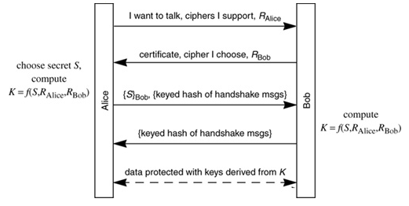
“Core” SSL 3.0 Handshake
The reading shows the above protocol which is the same as the protocol in the previous slide. Find out the correspondence between the different notations that denote the same thing in these two protocols.
Notes:
This slide shows the 'core' SSL 3.0 handshake from a reading, which uses different notation than previous slides. Students should compare the two representations and identify correspondences - Nc and Ns are nonces, Ks is the server's public key, sigca is the CA signature. This exercise helps students understand that the same protocol can be described using different notations.

Slide 65
“Core” SSL 3.0 Handshake
Version_{c}=3.0, suite_{c}, N_{c}
C
S
Version_{s}=3.0, suite_{s}, N_{s},
sig_{ca}(S,K_{s}),
“ServerHelloDone”
{Secret_{c}}_{Ks}
If the protocol is correct, C and S share
some secret key material (secret_{c}) at this point
switch to key derived
from secret_{c}, N_{c}, N_{s}
switch to key derived
from secret_{c}, N_{c}, N_{s}
Notes:
This slide shows both client and server exchanging the secret key material encrypted with the server's public key {Secretc}Ks, then both switching to keys derived from the shared secret and nonces. The question is: do C and S share the same key? The answer is yes - both sides can independently derive the same session keys from the pre-master secret and the random nonces.

Slide 66
Version Downgrade Attack
Version_{c}=2.0, suite_{c}, N_{c}
S
C
Server is fooled into thinking it communicating with a client who supports only SSL 2.0
Version_{s}=2.0, suite_{s}, N_{s},
sig_{ca}(S,K_{s}),
“ServerHelloDone”
{Secret_{c}}_{Ks}
C and S end up communicating using SSL 2.0
(weaker earlier version of the protocol that
does not include “Finished” messages)
Notes:
This demonstrates a version downgrade attack on TLS/SSL. An attacker intercepts and modifies the ClientHello version number from 3.0 to 2.0, making it appear the client only supports SSL 2.0. The server agrees to use SSL 2.0, which is weaker and lacks security features like Finished messages. This is a classic downgrade attack where an attacker forces the use of a weaker protocol version to exploit known vulnerabilities.

Slide 67
SSLv2 Weaknesses (Fixed in SSLv3)
Downgrade attack
Cipher suite preferences are not authenticated
“Cipher suite rollback” attack is possible
Truncation attack
Weak MAC construction
MAC hash uses only 40 bits in export mode
Notes:
This slide lists SSL 2.0 security weaknesses that were fixed in SSL 3.0: Downgrade attacks possible (cipher suite preferences not authenticated), truncation attacks, weak MAC construction (only 40 bits in export mode), no certificate chains, no non-RSA algorithms, and no handshake renegotiation. These weaknesses made SSL 2.0 unacceptable for security-critical applications.

Slide 68
“Chosen-Protocol” Attacks
Why do people release new versions of security protocols?
New version must be backwards-compatible
Not everybody upgrades right away
Attacker can fool parties into using the old, broken version and exploit known vulnerability
Similar: fool victim into using weak crypto algorithms
Defense is hard: must authenticate version early
Many protocols had “version rollback” attacks
SSL, SSH, GSM (cell phones)
Notes:
This discusses 'chosen-protocol' or version rollback attacks. The fundamental problem: new protocol versions must be backwards-compatible, so attackers can fool victims into using old, broken versions and exploit known vulnerabilities. Defending is hard because you must authenticate the version choice early in the handshake. Many protocols have had version rollback attacks: SSL, SSH, and GSM. The lesson: backwards compatibility often creates security vulnerabilities.

Slide 69
Version Check in SSL v3
Version_{c}=3.0, suite_{c}, N_{c}
S
C
Version_{s}=3.0, suite_{s}, N_{s},
sig_{ca}(S,K_{s}),
“ServerHelloDone”
“Embed” version number into secret
Check that received version is equal to the version in ClientHello
{Version_{c},Secret_{c}}_{Ks}
If the protocol is correct, C and S share
some secret key material secret_{c} at this point
switch to key derived
from secret_{c}, N_{c}, N_{s}
switch to key derived
from secret_{c}, N_{c}, N_{s}
Notes:
This shows how SSL 3.0 defends against version downgrade attacks. The defense is embedding the version number into the encrypted pre-master secret: {Versionc, Secretc}Ks. When the server decrypts this, it checks that the embedded version matches the ClientHello version. If an attacker modified the ClientHello to downgrade, the embedded version (encrypted and unmodifiable) won't match, and the handshake fails. This authenticates the version choice before encrypted session begins.

Slide 70
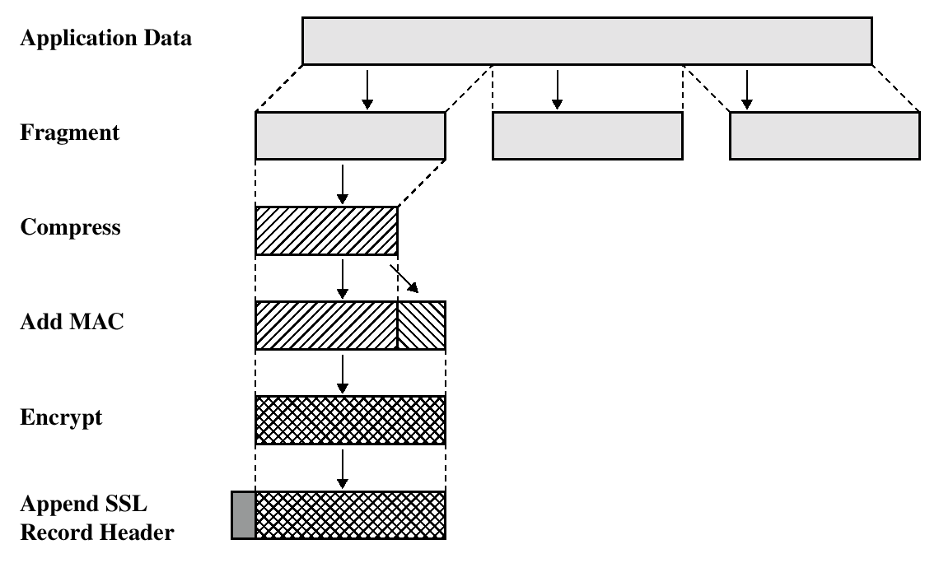
SSL/TLS Record Protection
Use symmetric keys
established in handshake protocol
Notes:
SSL/TLS Record Protection uses the symmetric keys established during the handshake to protect data transmission. While the handshake uses expensive public-key cryptography, the record protocol uses fast symmetric cryptography for bulk data. All application data is broken into records, each encrypted and authenticated using the shared session key, providing confidentiality and integrity.

Slide 71
SSL Handshake Protocol: Additional Features
SSL Handshake Protocol supports session resumption and ciphersuite re-negotiation.
Allows authentication and shared secrets to be reused across multiple connections.
Eg, next webpage from same website.
Allows re-keying of current connection using fresh nonces.
Allows change of ciphersuite during session.
ClientHello quotes old SessionID.
Both sides contribute new nonces, update secret_{c.}
All protected by existing Record Protocol.
Notes:
Additional SSL/TLS handshake features include session resumption and ciphersuite renegotiation. Session resumption allows reusing authentication and secrets across multiple connections without repeating expensive public-key operations. The protocol also supports re-keying with fresh nonces and changing ciphersuites mid-session. ClientHello quotes the old SessionID to resume. All renegotiation is protected by the existing Record Protocol.

Slide 72
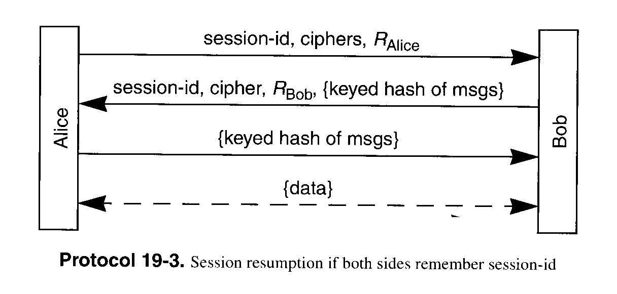
Session Resumption
Avoid public key operation if both sides remember session ID
Notes:
Session resumption is an important performance optimization. The full TLS handshake requires expensive public-key operations. To avoid repeating this for multiple connections, both sides can remember the session ID and keys. When reconnecting, the client sends the previous session ID. If the server has it cached, both skip public-key operations and resume using cached keys. This significantly reduces latency and CPU usage. The tradeoff is servers must maintain session state.

Slide 73
Some SSL/TLS Security Flaws
(Historical) flaws in random number generation for SSL
Low quality RNG leads to predictable session keys.
Goldberg and Wagner, Dr. Dobb’s Journal, Jan. 1996.
Flaws in error reporting
(differing response times by server in event of padding failure and MAC failure) + (analysis of padding method for CBC-mode) = recovery of SSL plaintext.
Canvel, Hiltgen, Vaudenay and Vuagnoux, Crypto2003.
Timing attacks
analysis of OpenSSL server response times allows attacker in same LAN segment to derive server’s private key!
Boneh and Brumley, 12th Usenix Security Symposium.
Notes:
This discusses historical SSL/TLS implementation flaws. Goldberg and Wagner (1996) found flaws in Netscape's random number generation - poor RNGs led to predictable session keys. Canvel et al. (2003) discovered timing side-channels from different error responses for padding vs MAC failures. Boneh and Brumley (2003) showed timing attacks on OpenSSL's RSA operations allowed recovering the server's private key. These examples show that even with correct protocol design, implementation flaws can completely undermine security. Side-channel attacks are particularly subtle and dangerous.

Slide 74

Notes:
[Slide appears to be blank - possibly a transition or contains only an image]

Slide 75
TLS Heartbeat Extension
DTLS is designed to secure traffic running on top of unreliable
transport protocols. Usually, such protocols have no session
management. The only mechanism available at the DTLS layer to figure
out if a peer is still alive is a costly renegotiation, particularly
when the application uses unidirectional traffic. Furthermore, DTLS
needs to perform path MTU (PMTU) discovery but has no specific
message type to realize it without affecting the transfer of user
messages.
TLS is based on reliable protocols, but there is not necessarily a
feature available to keep the connection alive without continuous
data transfer.
The Heartbeat Extension as described in this document overcomes these
limitations. The user can use the new HeartbeatRequest message,
which has to be answered by the peer with a HeartbeartResponse
immediately.
Notes:
The TLS Heartbeat Extension (RFC 6520) provides a keep-alive mechanism. For DTLS (TLS over UDP), it checks if a peer is still alive without expensive renegotiation. For TLS over TCP, it keeps connections alive without continuous data transfer. One endpoint sends a HeartbeatRequest with a payload, and the peer responds with a HeartbeatResponse containing the same payload. As we'll see next, a critical implementation bug turned this into one of the most serious security vulnerabilities in Internet history.

Slide 76
OpenSSL “Heartbleed” Bug
Announced April 2014.
Exploits a programming mistake in the OpenSSL implementation of the TLS ``heartbeat hello’’ extension.
Heartbeat protocol is used to keep a TLS connection alive without continuously transferring data.
One endpoint (e.g., a Web browser) sends a HeartbeatRequest message containing a payload to the other endpoint (e.g. a Web server). The server then sends back a HeartbeatReply message containing the same payload.
“Buffer over-read” error caused by a failure to check for an invalid read-length parameter.
Notes:
The Heartbleed bug (April 2014) is a critical vulnerability in OpenSSL's implementation of the TLS heartbeat extension. The vulnerability is a 'buffer over-read' caused by failing to validate the read-length parameter. The attack: send a HeartbeatRequest claiming to have a large payload (64KB) but actually send only 1 byte. The vulnerable OpenSSL code reads 64KB from memory, including 64KB-1 bytes of whatever is beyond the payload - session keys, passwords, private keys, or other sensitive data. Heartbleed affected hundreds of thousands of servers and required mass patching. It highlights the danger of memory safety issues in C code.

Slide 77
From RFC 6520
Heartbeat Request and Response Messages
The Heartbeat protocol messages consist of their type and an arbitrary
payload and padding.
struct {
HeartbeatMessageType type;
uint16 payload_length;
opaque payload[HeartbeatMessage.payload_length];
opaque padding[padding_length];
} HeartbeatMessage;
The total length of a HeartbeatMessage MUST NOT exceed 2^14 or
max_fragment_length when negotiated as defined in [RFC6066].
type: The message type, either heartbeat_request or heartbeat_response.
payload_length: The length of the payload.
payload: The payload consists of arbitrary content.
padding: The padding is random content that MUST be ignored by the receiver.
Problem: no check that payload_length matches the actual length of the payload
Notes:
This shows the RFC 6520 HeartbeatMessage structure: type (request/response), payload_length (length of payload), payload (arbitrary content), and padding (random content). The Heartbleed bug occurred because OpenSSL didn't validate that the payload_length field matched the actual payload size. An attacker could send payload_length=64000 but only 1 byte of actual payload, and OpenSSL would read 64000 bytes from memory. This is a classic example of why input validation is critical, especially for length fields. Always validate that claimed lengths match actual data sizes before using them in memory operations.

